Slide 1
File Transfer Using Java Sockets Send/Receive Images, Videos, Audio, and Files
GROUP MEMBERS:
K.PHANINDRA REDDY-BU22CSEN0101454
I.ABHISHEIK-BU22CSEN0101761
A.GOWTHAM VENKAT REDDY- BU22CSEN0101513
S.VAMSI KRISHNA-BU22CSEN0100600

Slide 2
Introduction to File Transfer
File transfer is a critical aspect of modern computing and networking, allowing users to share and exchange files between devices. Whether it's sending documents, images, videos, or other types of files, efficient file transfer mechanisms are essential for various applications and industries.
Types of Files: Files can range from text documents and spreadsheets to multimedia files like images, videos, and audio recordings.
Challenges: Challenges in file transfer include ensuring data integrity, managing large file sizes, and maintaining security and privacy.

Slide 3
Server-Side Algorithm
1. Start
2. Create ServerSocket
3. Bind to Port
4. Listen for Clients
5. Accept Client Connection
6. Receive File
7. Save File
8. Send Confirmation
9. Close Connection
10. Listen for Next Client
11. End

Slide 4
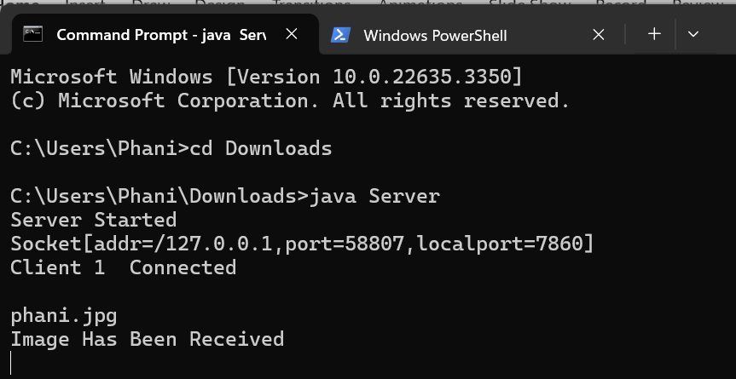
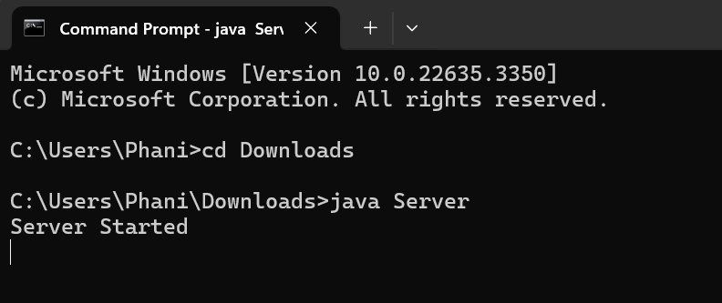
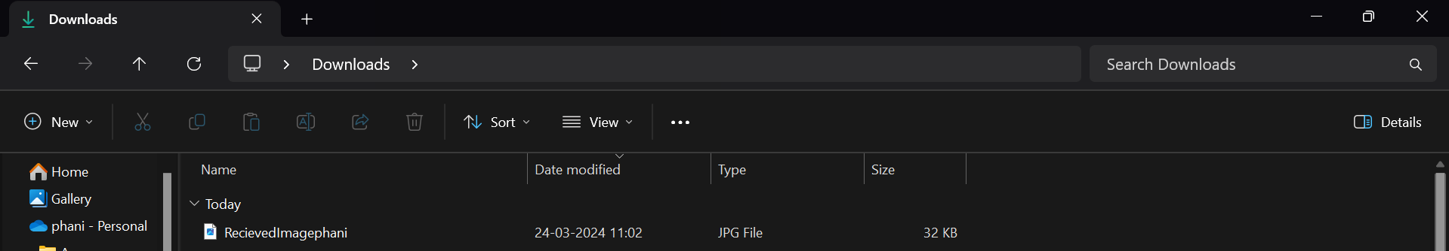
Running Server Source Code

Slide 5
Client-Side Overview
The client side of the file transfer application is responsible for providing a user-friendly interface for selecting files and initiating the transfer process. It utilizes Java's Abstract Window Toolkit (AWT) for creating a simple GUI. Here's a breakdown of its key components and functionality:
Event Handling
File Transfer Logic
Error Handling
Socket Connection
Window Closing Handling

Slide 6
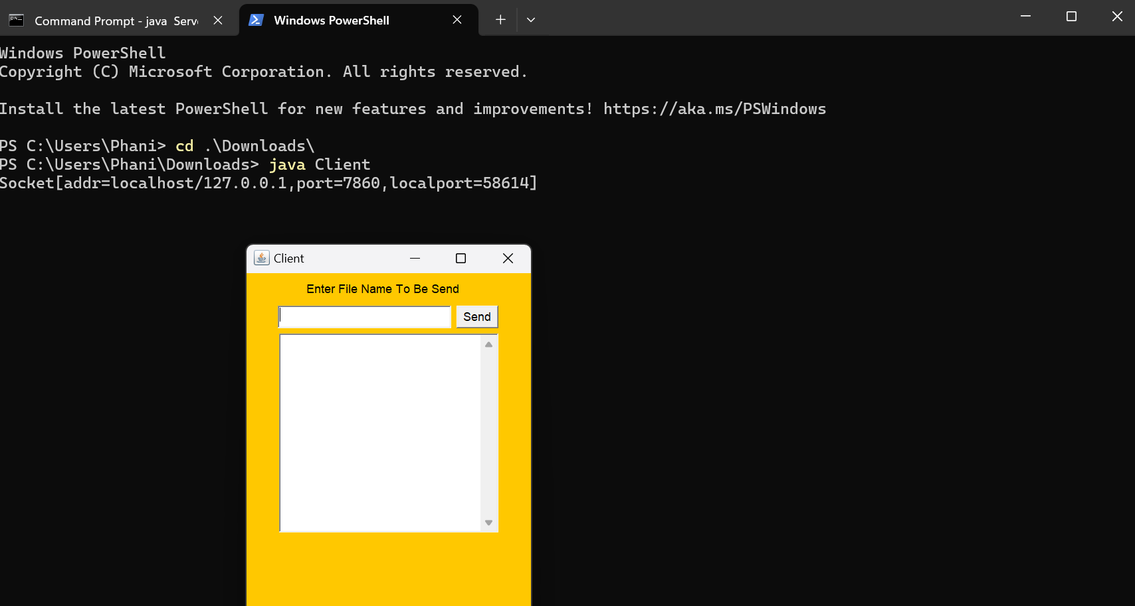
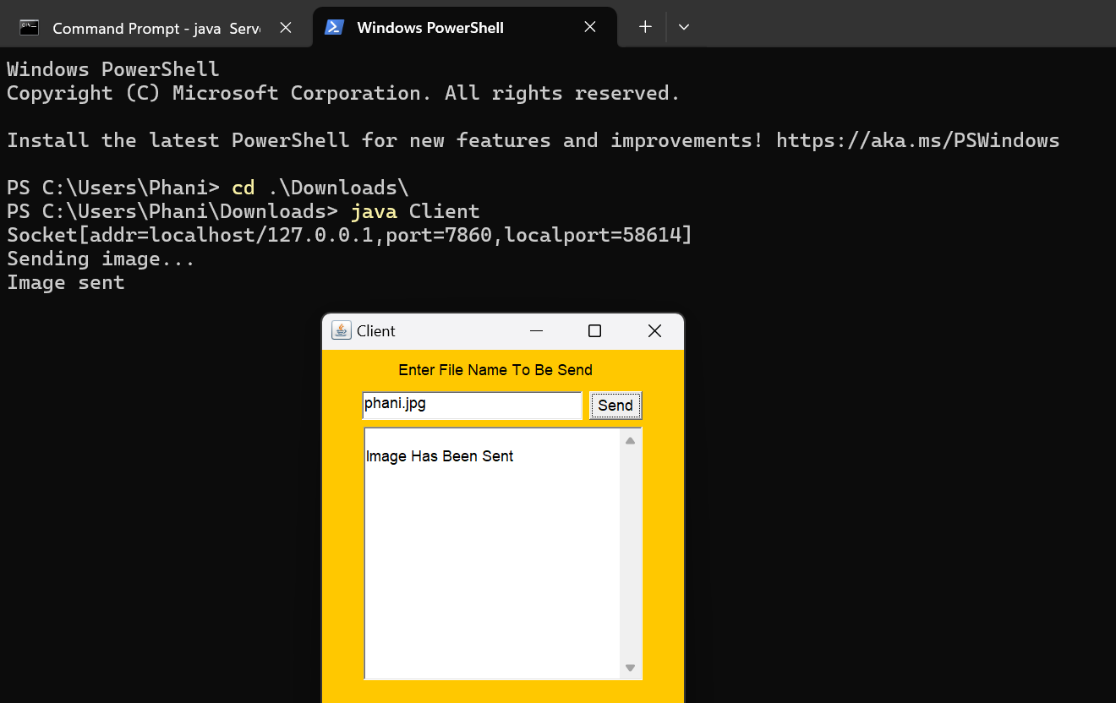
Running Client Source Code

Slide 7
Supported File Types
Images:
Formats: .jpg, .jpeg, .png,
Description: Images are commonly used for graphics and visual content.
Videos:
Formats: .mp4, .avi, .mkv, etc.
Description: Videos are used for motion picture and multimedia content.
Audio:
Formats: .mp3, .wav, .aac, etc.
Description: Audio files are used for sound and music playback.
Other Files:
Formats: Any file format can be sent.
Description: This includes documents, spreadsheets, presentations, and other types of files.

Slide 8
File Sending Process
Step-by-step explanation of the file sending process:User selects the file type and browses for the file.
File is read and sent to the server based on its type.
Server receives and saves the file according to its type.

Slide 9
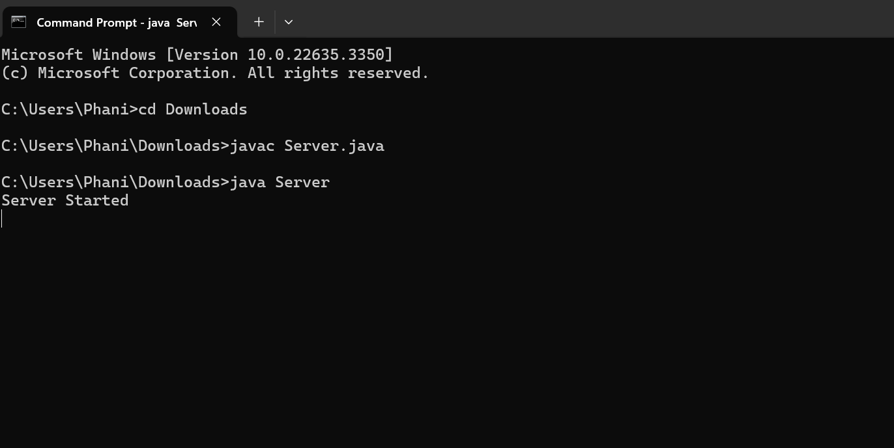
Step1:Run Server

Slide 10
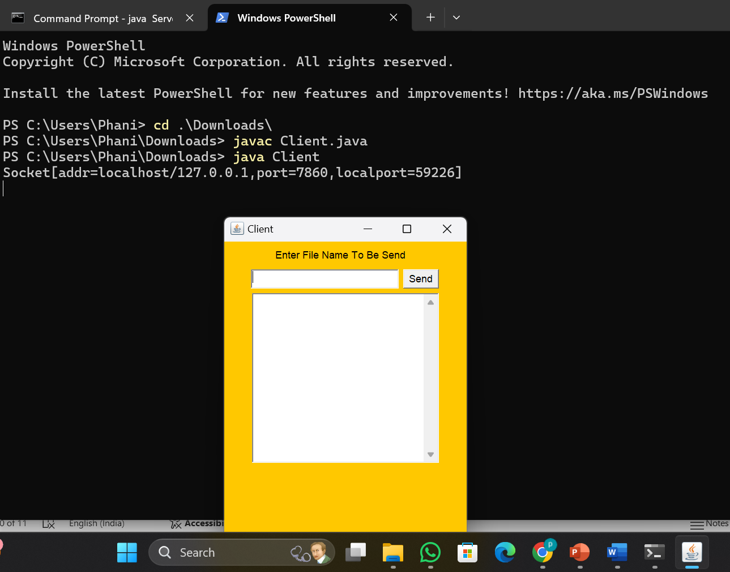
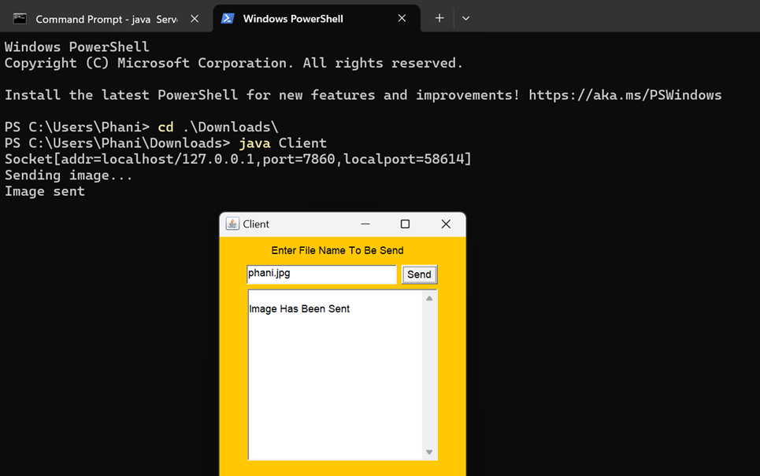
Step2:Run Client

Slide 11
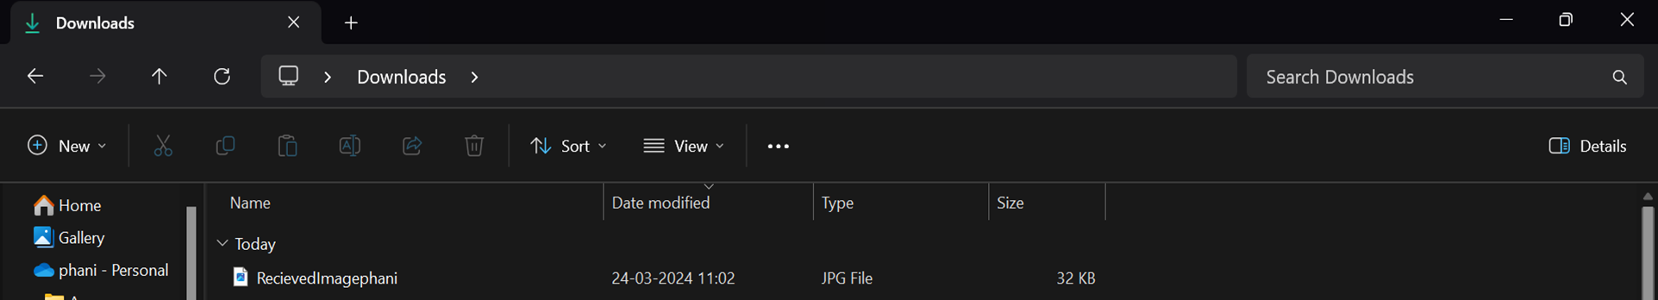
Step3:Received file from Client Saved in disc

Slide 12
Conclusion:
In conclusion, the file transfer system using Java sockets provides a robust and efficient solution for sending various types of files between clients and servers.
Throughout this presentation, we have seen how this system allows users to send images, videos, audio files, and other types of files with ease.

